Slide 1
Analysis of Post Pandemic Inflation
Prepared by: Rob Wygant

Slide 2
Purpose
Inflation affects purchasing power as prices for investments, commodities and consumer goods increase on different time horizons
Explore lagging effects of inflation on different categories in order to better understand of how to preserve purchasing power during high inflationary periods.

Slide 3
Tools and Methods
All data sets collected from “Economic Research (Federal Reserve Bank of St. Louis”
https://fred.stlouisfed.org/
Downloaded 16 CSV files to Pandas dataframe
Cleaning time series data function: reindexing, reformatting date, NaN values, sizing, merge
Saved dataframe and uploaded to analysis/plotting Python script
Utilized plotly graphing library
Version control with GitHub
https://github.com/wygantro/NYCDSA_Project_1.git

Slide 4
Cause of Post Pandemic Inflation
COVID hits March, 2020
GDP immediately drops
Government expands money supply
Increased money supply combined with low economic output, created a situation where a lot of money flowed to assets and consumer products
Government issues debt
Federal reserve buys debt in form of bonds
Money supply increases

Slide 5
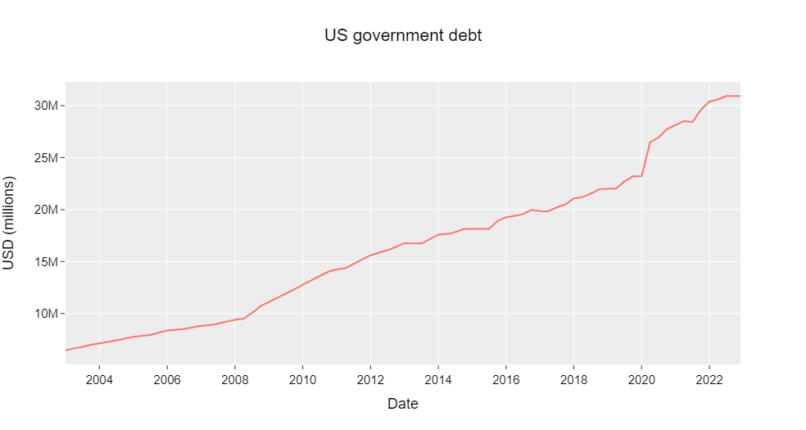
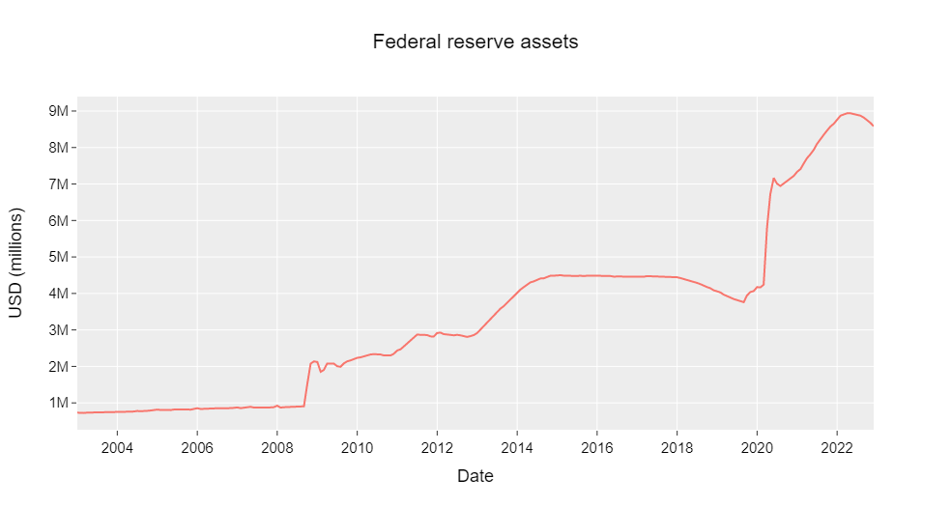
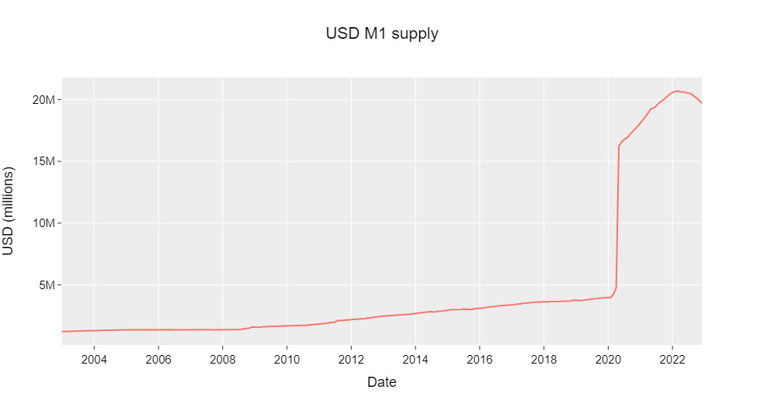
Government issues debt
Federal reserve buys debt in form of bonds
Money supply increases

Slide 6
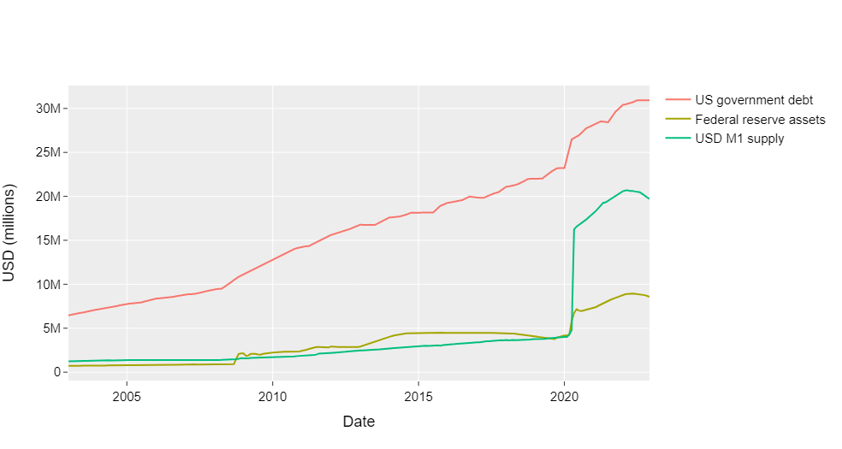
Government issues debt
Federal reserve buys debt in form of bonds
Money supply increases
Consolidated plot

Slide 7
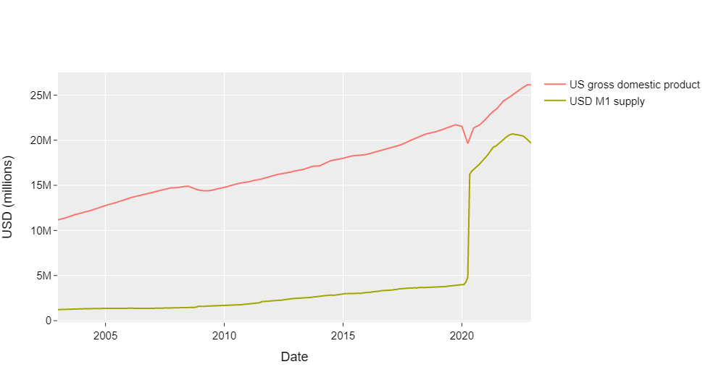
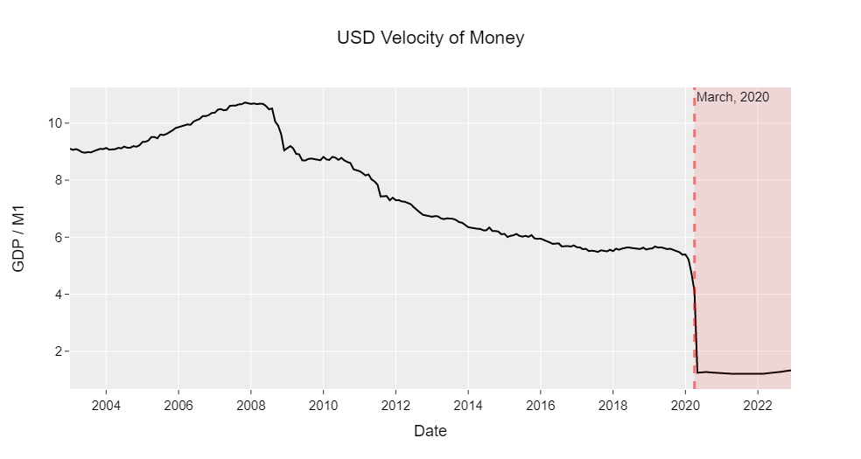
COVID Shutdown (March, 2020)
Economic shutdown (decrease in GDP)
velocity of money = GDP÷(M1 money supply)

Slide 8
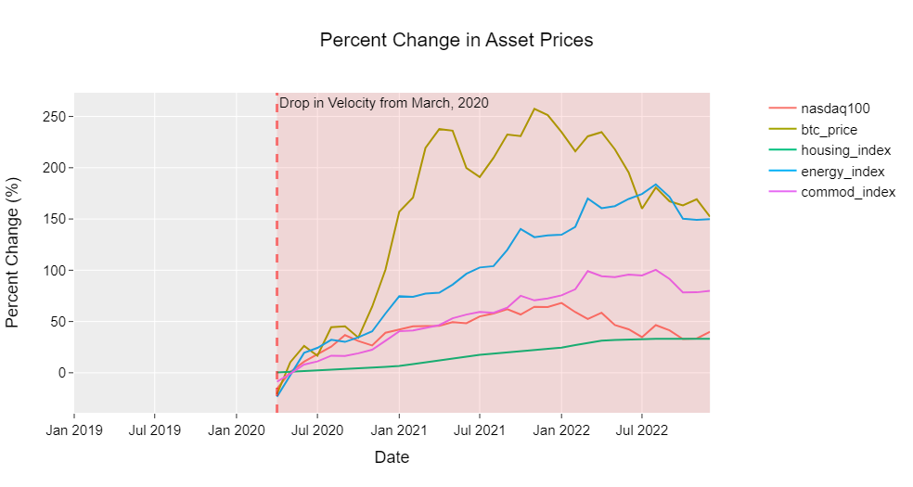
Economic slowdown
+
Increase in money supply
Asset Inflation
Notes:
Change y-axis to percentage

Slide 9
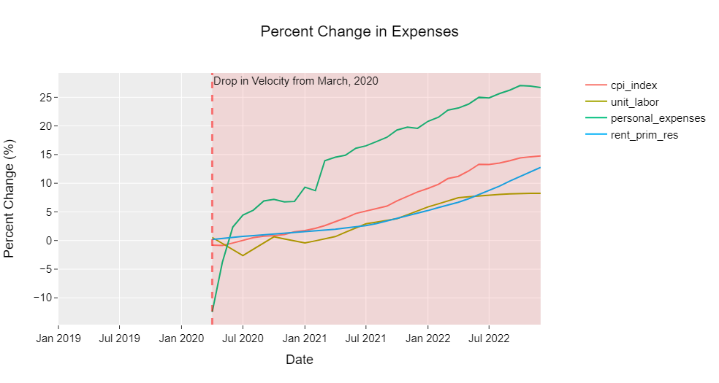
Economic slowdown
+
Increase in money supply
Price Inflation
Notes:
Change y-axis to percentage

Slide 10
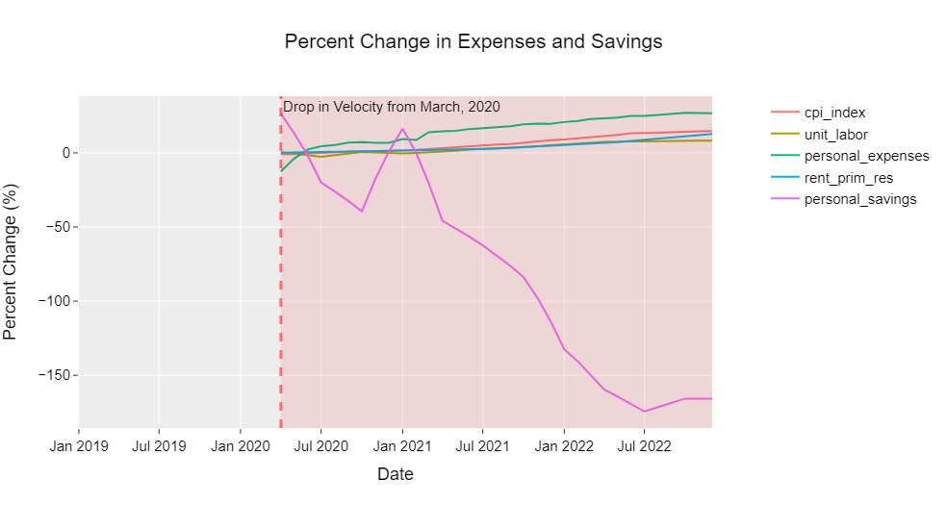
Economic slowdown
+
Increase in money supply
Decrease in Personal Savings
Notes:
Change y-axis to percentage

Slide 11
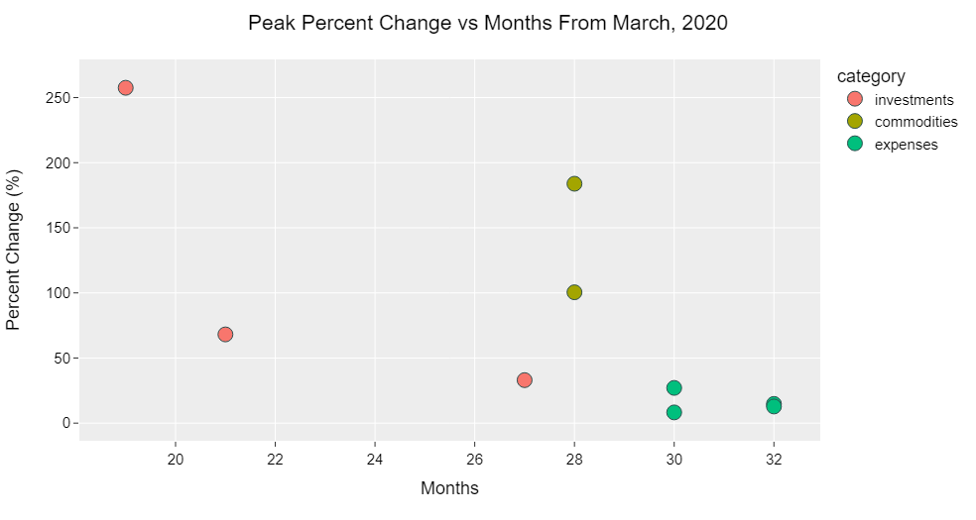
Inflationary response over time

Slide 12
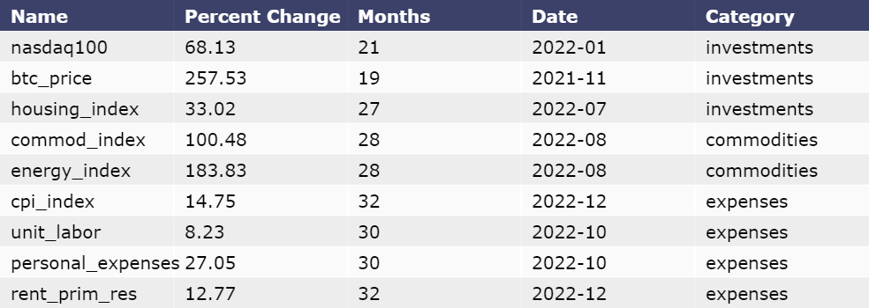
Peak percent change in asset prices

Slide 13
Outcome and Future Analysis
Increase in money supply and decrease in economic output, causes a flow of inflation into investments, then commodities and finally consumer prices
Potential hedge against loss of purchasing power by initially holding investments and commodities
Future Analysis:
Model response and response time of different investment categories based on change in velocity of money
Market cap
Liquidity
Elasticity (scarcity)

